Slide 1
Genomic Selection in U.S. Cattle Breeding
George Wiggans, CDCB Technical Advisor

Slide 2
Highlights of U.S. system
Over half a million animals genotyped in 2016
67% of AI breedings to genomic bulls
Genomic relationship between genotyped cows and marketed bulls available
Evaluations on new animals released weekly

Slide 3
Genomic data flow
Animal owner
DNA samples
DNA samples
genomic
evaluations
DNA laboratory
DNA samples
Nominator
genotypes
genotypes
nominations,
pedigree data
genotype
quality reports
genomic
evaluations
Council on Dairy Cattle Breeding (CDCB)
Notes:
3

Slide 4
Genotype counts by animal sex

Slide 5
Evaluation flow
Animal nominated for genomic evaluation by approved nominator
DNA source sent to genotyping lab (2016)
Source | Samples (no.) | Samples (%)
Blood | 12,848 | 3
Hair | 108,925 | 24
Nasal swab | 1,176 | <1
Semen | 3,196 | 1
Tissue | 308,105 | 67
Unknown | 28,179 | 6

Slide 6
Genotype counts by chip density (2016)

Slide 7
Laboratory quality control
Each SNP evaluated for
  Call rate
  Portion heterozygous
  Parent-progeny conflicts (97% of sires & 38% of dams genotyped)
Clustering investigated if SNP exceeds limits
Number of failing SNPs indicates quality of submission
Target of <10 SNPs in each category (varies by chip size)

Slide 8

Parentage validation and discovery
Parent-progeny conflicts detected
  Animal checked against all other genotypes
  Reported to breeds and requesters
  Correct sire usually detected
Maternal grandsire checked
  Less certain than parentage checking
Who’s your daddy?

Slide 9
Imputation
Based on splitting genotype into individual chromosomes (maternal and paternal contributions)
Missing SNPs assigned by observing SNPs in ancestors and descendants
Imputed dams increase predictor population
Genotypes from all chips merged by imputing SNPs not present

Slide 10

Gene tests (imputed and actual)
Holstein
  Bovine leucocyte adhesion deficiency (BLAD)
  Complex vertebral malformation (CVM)
  Deficiency of uridine monophosphate synthase (DUMPS)
  Syndactyly (mulefoot)
  Cholesterol deficiency
  Red coat color
Brown Swiss
  Weaver Syndrome
  Spinal dismyelination (SDM)
  Spinal muscular atrophy (SMA)
Polledness (Holstein, Jersey, Brown Swiss)

Slide 11
Haplotypes affecting fertility
Name | Chromosome* | Location** (Mbp) | Carrier frequency (%)*** | Earliest known genotyped ancestor
HH1 | 5 | 63.2** | 3.8 | Pawnee Farm Arlinda Chief
HH2 | 1 | 94.9 – 96.6 | 3.3 | Willowholme Mark Anthony
HH3 | 8 | 95.4** | 5.9 | Glendell Arlinda Chief, Gray View Skyliner
HH4 | 1 | 1.3** | 0.7 | Besne Buck
HH5 | 9 | 93.2 – 93.4 | 4.4 | Thornlea Texal Supreme
JH1 | 15 | 15.7** | 24.2 | Observer Chocolate Soldier
JH2 | 26 | 8.8 – 9.4 | 2.6 | Liberators Basilius
BH1 | 7 | 42.8 – 47.0 | 13.3 | West Lawn Stretch Improver
BH2 | 19 | 11.1** | 15.6 | Rancho Rustic My Design
AH1 | 17 | 65.9** | 26.0 | Selwood Betty’s Commander
AH2 | 3 | 51.3** | 19.7 | Oak-Ridge Flashy Kellogg
*Bos taurus (BTA) **Causative mutation known; Mbp = megabase pairs ***At first evaluation release

Slide 12
AI breedings to genomic bulls

Slide 13
Generation interval – Holstein

Slide 14
Release of evaluations
Download from CDCB FTP site with
separate files for each nominator
Weekly release of evaluations of new animals
Monthly release for females and bulls not marketed
All genomic evaluations updated 3 times each year with traditional evaluations

Slide 15
Marketed Holstein bulls

Slide 16
A glance at the future
Increasing number of cows genotyped
Falling cost per SNP genotyped
Increased accuracy of genomic evaluations from more informative SNPs
Genomic evaluations on more traits to predict economic merit more accurately
Increased use of genomics in mating programs

Slide 17
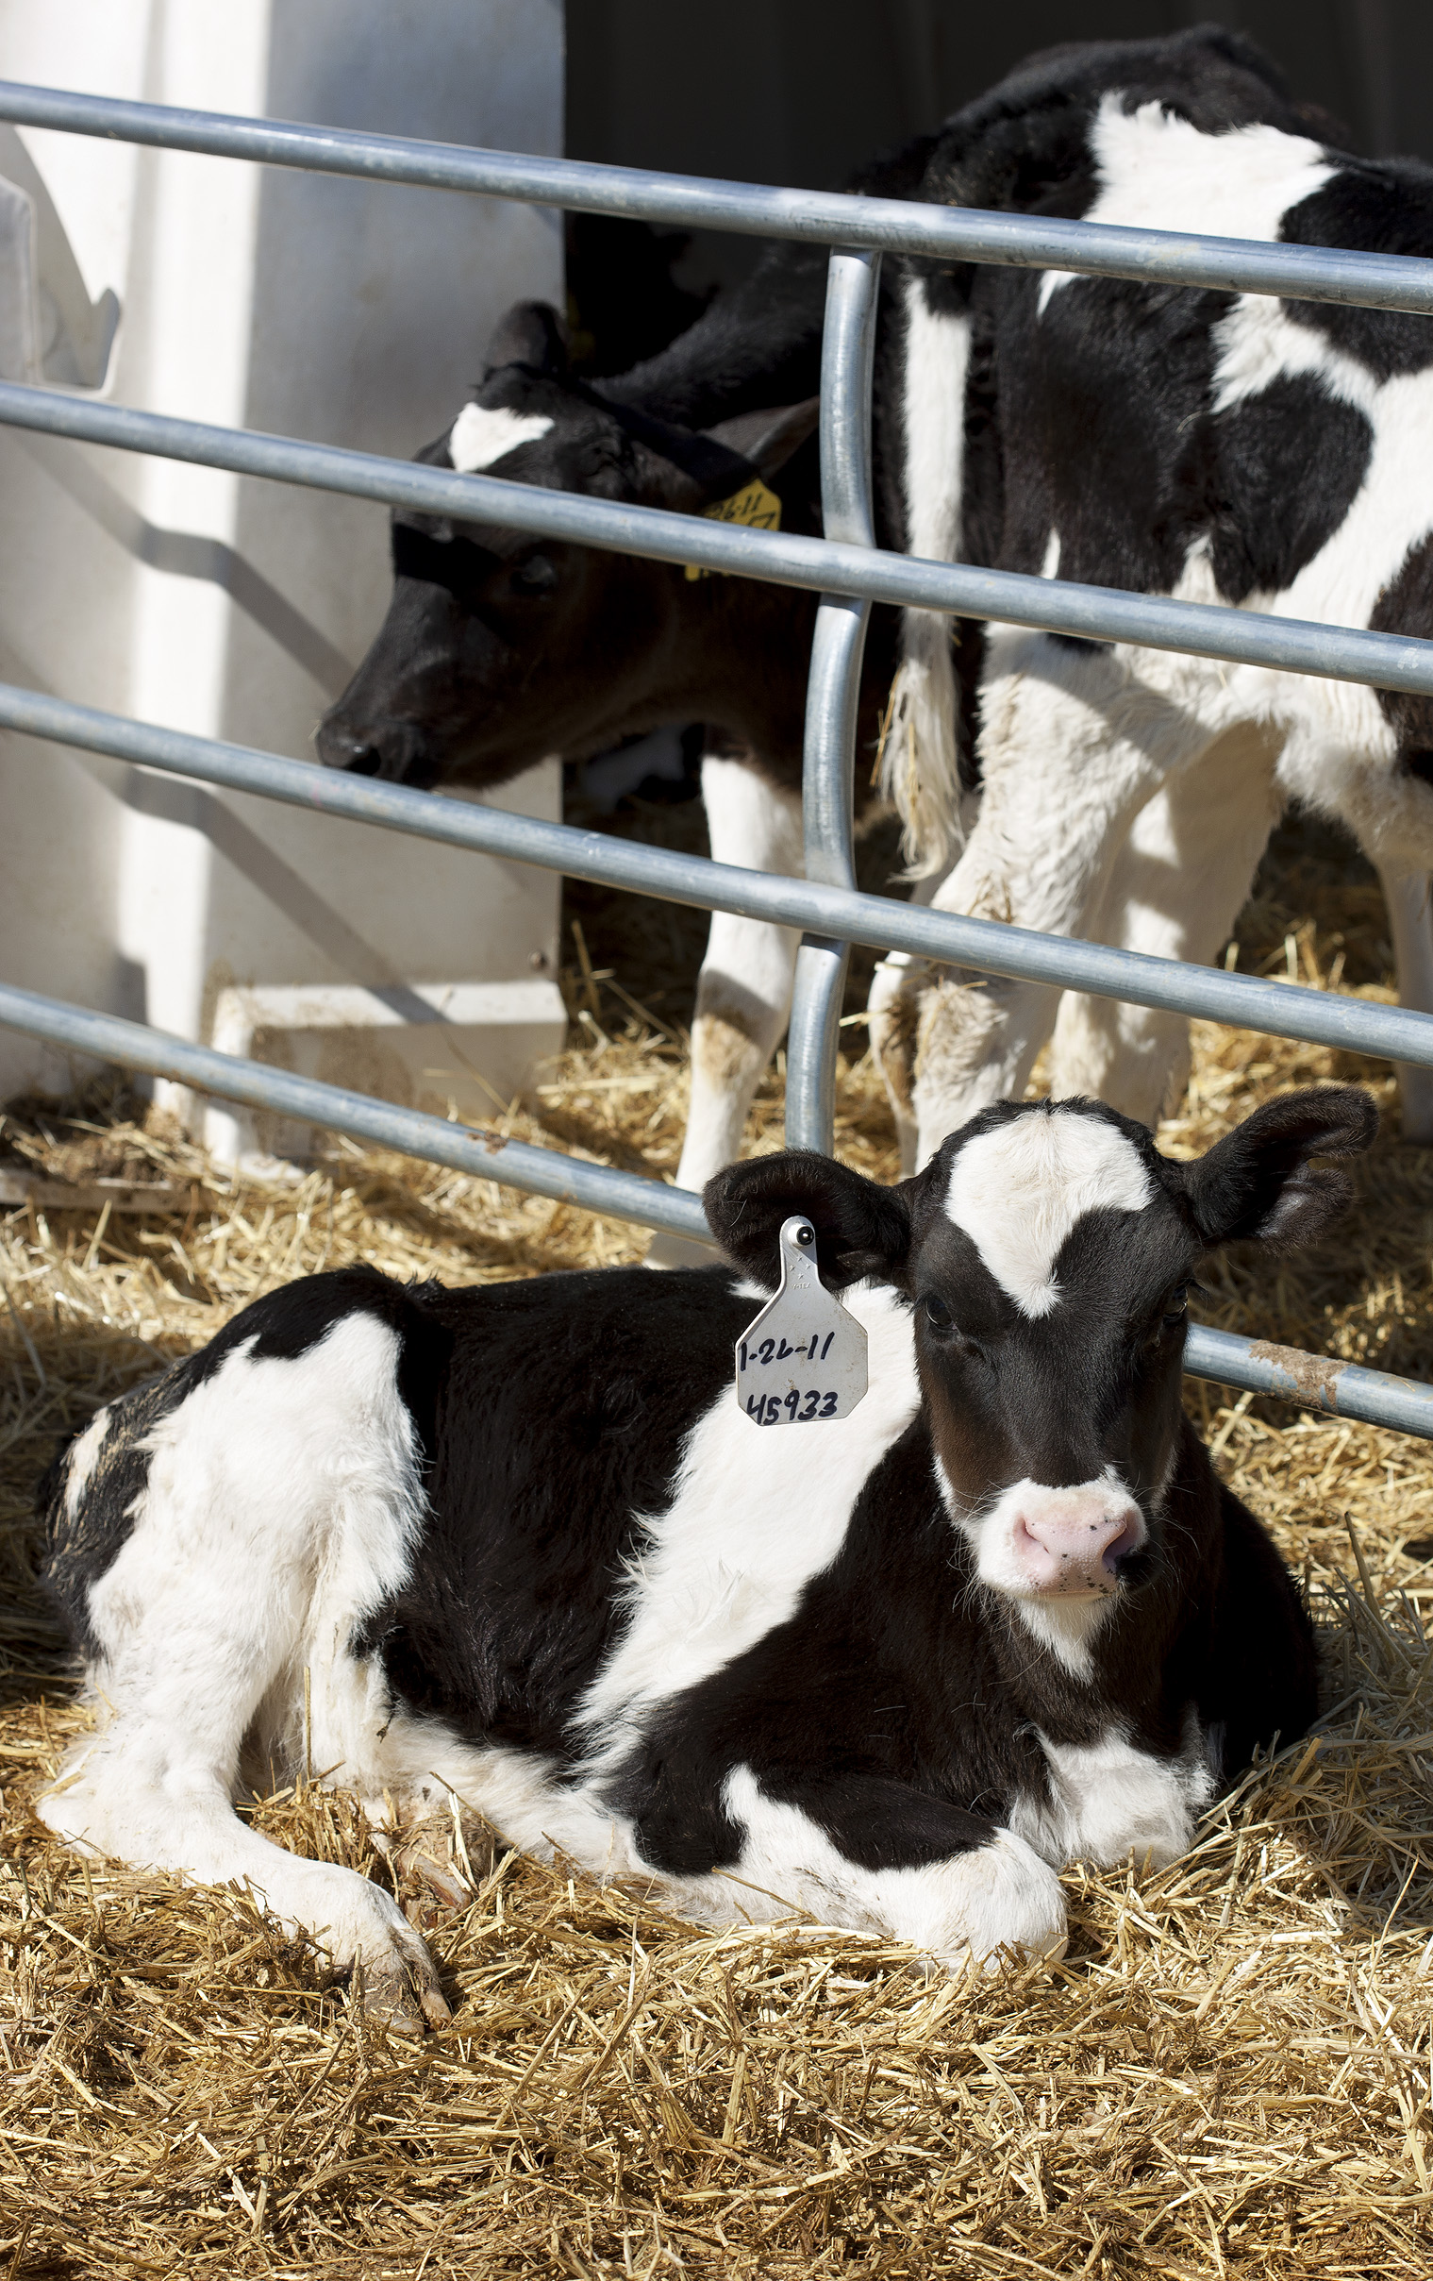
Evaluation of new traits
Mortality – Added August 2016
Gestation length – Added August 2017
Health traits –December test planned
Feed efficiency – Under development

Slide 18
Characteristics of U.S. system
Highly successful program leading to increasing annual increases in genetic merit for production efficiency
Large database of phenotypic and genomic data provided by industry
Research projects underway to determine mechanism of genetic control of economically important traits
Data processing techniques periodically modified so that rapid turnaround can be maintained

Slide 19

Questions?

