Slide 1
How selection for better health impacts dairy profitability
John B. Cole
USDA, Agricultural Research Service
Henry A. Wallace Beltsville Agricultural Research Center
Animal Genomics and Improvement Laboratory
Beltsville, MD 20705-2350
john.cole@ars.usda.gov

Slide 2
Introduction
How does genetic selection work?
What’s the best way to select for many traits?
Is it s good idea to select for low-heritability traits?
How does dairy cow health affect farm profitability?

Slide 3

How does genetic selection work?
ΔG = genetic gain each year
reliability = how certain we are about our estimate of an animal’s genetic merit (genomics ⬆)
selection intensity = how selective we are when making mating decisions (management can ⬆)
genetic variance = variation in the population due to genetics (we can’t really change this)
generation interval = time between generations (genomics ⬇)

Slide 4
Genetic improvement is successful
In 2015: 1957 base was 44% of total fat,
management was 28% of gains, and
genetics was 28% of gains

Slide 5
Large populations have advantages
 | BS | HO
N | 81 | 1,796
Mean | 368 | 580
SD | 477 | 769
Min | -845 | -3,052
Max | 1,350 | 3,129

Slide 6
Many things affect performance
P = G + E
Additive effects
Dominance effects
Epistasis
Housing
Climate
Unknown
What about G×E?
Effects generally small in the US (e.g., Wright and VanRaden, 2015)

Slide 7
Sources of phenotypic variation
Fat yield (h² = 0.20)
Genetics:
20 %
Environment:
80%
Clinical mastitis (h² = 0.03)
Genetics: 3 %
Environment:
97%
Who controls what?
Genetics:
Variance is constant
Environment:
Farmers can change this

Slide 8
Heritability of Holstein traits
Trait | h² |  | Trait | h²
Milk yield | Trait |  | SCS | 0.12
Fat yield | 0.20 |  | Productive life | 0.08
Fat percentage | 0.20 |  | Livability | 0.0062
Protein yield | 0.20 |  | DPR | 0.014
Protein percentage | 0.20 |  | HCR | 0.01
Strength | 0.31 |  | CCR | 0.016
Stature | 0.42 |  | SCE | 0.086
Body depth | 0.37 |  | DCE | 0.048
Rump width | 0.26 |  | Gestation length | 0.44
Source: CDCB (https://www.uscdcb.com/reference.htm), Holstein Association USA (http://www.holsteinusa.com/genetic_evaluations/ss_linear.html).

Slide 9
Why do populations improve over time?
We have become accustomed to steady improvements over time
  There is no guarantee of continuous gains (e.g., fertility)
All improvements are the result of deliberate decisions
  Bulls are selected to breed cows
  Environments are improved to permit expression of genetic potential
  Additional information is collected
Decisions must be based on data

Slide 10
Data contributes to gains in “E”
Annual Dairy Herd Information (DHI) reports released by CDCB
DHI Participation (NCDHIP Handbook Fact Sheet K-1)
State and National Standardized Lactation Averages by Breed for Cows on Official Test (NCDHIP Handbook Fact Sheet K-2)
Summary of DHIA Herd Averages (NCDHIP Handbook Fact Sheet K-3)
Dairy Records Processing Center Activity Summary (NCDHIP Handbook Fact Sheet K-6)
Somatic Cell Counts of Milk from DHI Herds
Reasons that Cows in DHI Programs Exit the Herd
Reproductive Status of Cows in DHI Programs
Source: https://queries.uscdcb.com/publish/dhi.cfm.

Slide 11
Why select for more than one trait?
To make use of more information
  Correlations among traits are rarely 0
Several traits may have economic value
  Farmers may receive a quality premium
Some traits need to be improved and others maintained
  Selection for only yield would reduce fertility
Balanced selection improves traits according to their economic values

Slide 12
Traits routinely evaluated in the US
Year | Trait | Year | Trait
1926 | Milk & fat yields | 2006 | Stillbirth rate
1978 | Conformation (type) | 2006 | Bull conception rate²
1978 | Protein yield | 2009 | Cow & heifer conception rates
1994 | Productive life | 2016 | Cow livability
1994 | SCS (udder health) | 2017 | Gestation length
2000 | Calving ease (dystocia)¹ | 2017 | Residual feed intake (research)³
2003 | Daughter pregnancy rate | 2018 | Disease resistance (6 traits) ⁴
¹Sire calving ease evaluated by Iowa State University (1978–99)
²Estimated relative conception rate evaluated by DRMS in Raleigh, NC (1986–2005)
³Research trait … no official evaluations yet
⁴Official evaluations launched April 2018

Slide 13
Current genetic-economic indices (2017)
Trait | Relative value (%)
 | NM$ | CM$ | FM$ | GM$
Milk yield | –0.7 | –7.9 | 20.4 | –0.5
Fat yield | 23.7 | 20.1 | 24.3 | 20.7
Protein yield | 18.3 | 22.0 | 0.0 | 16.0
Productive life (PL) | 13.4 | 11.4 | 13.8 | 7.8
Somatic cell score (SCS) | –6.5 | –7.0 | –3.2 | –5.5
Udder composite (UC) | 7.4 | 6.3 | 7.6 | 7.5
Feet/legs composite (FLC) | 2.7 | 2.3 | 2.8 | 2.8
Body weight composite (BWC) | –5.9 | –5.0 | –6.0 | –6.1
Daughter pregnancy rate (DPR) | 6.7 | 5.7 | 6.9 | 17.9
Heifer conception rate (HCR) | 1.4 | 1.2 | 1.4 | 2.5
Cow conception rate (CCR) | 1.6 | 1.4 | 1.7 | 4.4
Calving ability index (CA$) | 4.8 | 4.1 | 4.9 | 4.5
Cow livability (LIV) | 7.4 | 6.2 | 7.5 | 5.0

Slide 14
Index changes over time
Trait | Relative emphasis on traits (%)
 | PD$ 1971 | MFP$ 1976 | CY$ 1984 | NM$ 1994 | NM$ 2000 | NM$ 2003 | NM$ 2006 | NM$ 2010 | NM$ 2014 | NM$ 2017
Milk | 52 | 27 | –2 | 6 | 5 | 0 | 0 | 0 | –1 | –1
Fat | 48 | 46 | 45 | 25 | 21 | 22 | 23 | 19 | 22 | 24
Protein | … | 27 | 53 | 43 | 36 | 33 | 23 | 16 | 20 | 18
PL | … | … | … | 20 | 14 | 11 | 17 | 22 | 19 | 13
SCS | … | … | … | –6 | –9 | –9 | –9 | –10 | –7 | –7
UC | … | … | … | … | 7 | 7 | 6 | 7 | 8 | 7
FLC | … | … | … | … | 4 | 4 | 3 | 4 | 3 | 3
BWC | … | … | … | … | –4 | –3 | –4 | –6 | –5 | –6
DPR | … | … | … | … | … | 7 | 9 | 11 | 7 | 7
SCE | … | … | … | … | … | –2 | … | … | … | …
DCE | … | … | … | … | … | –2 | … | … | … | …
CA$ | … | … | … | … | … | … | 6 | 5 | 5 | 5
HCR | … | … | … | … | … | … | … | … | 1 | 1
CCR | … | … | … | … | … | … | … | … | 2 | 2
LIV | … | … | … | … | … | … | … | … | … | 7

Slide 15
Genetic trend (NM$)

Slide 16
What do others include in their index?

Slide 17
Why do we need new traits?
Changes in production economics
Technology produces new phenotypes or reduces costs of collecting them
  New traits can be predicted on all genotyped animals without collecting progeny records
  Phenotyping costs are shared among millions of animals
Better understanding of biology
Recent review by Egger-Danner et al. (Animal, 2015)

Slide 18
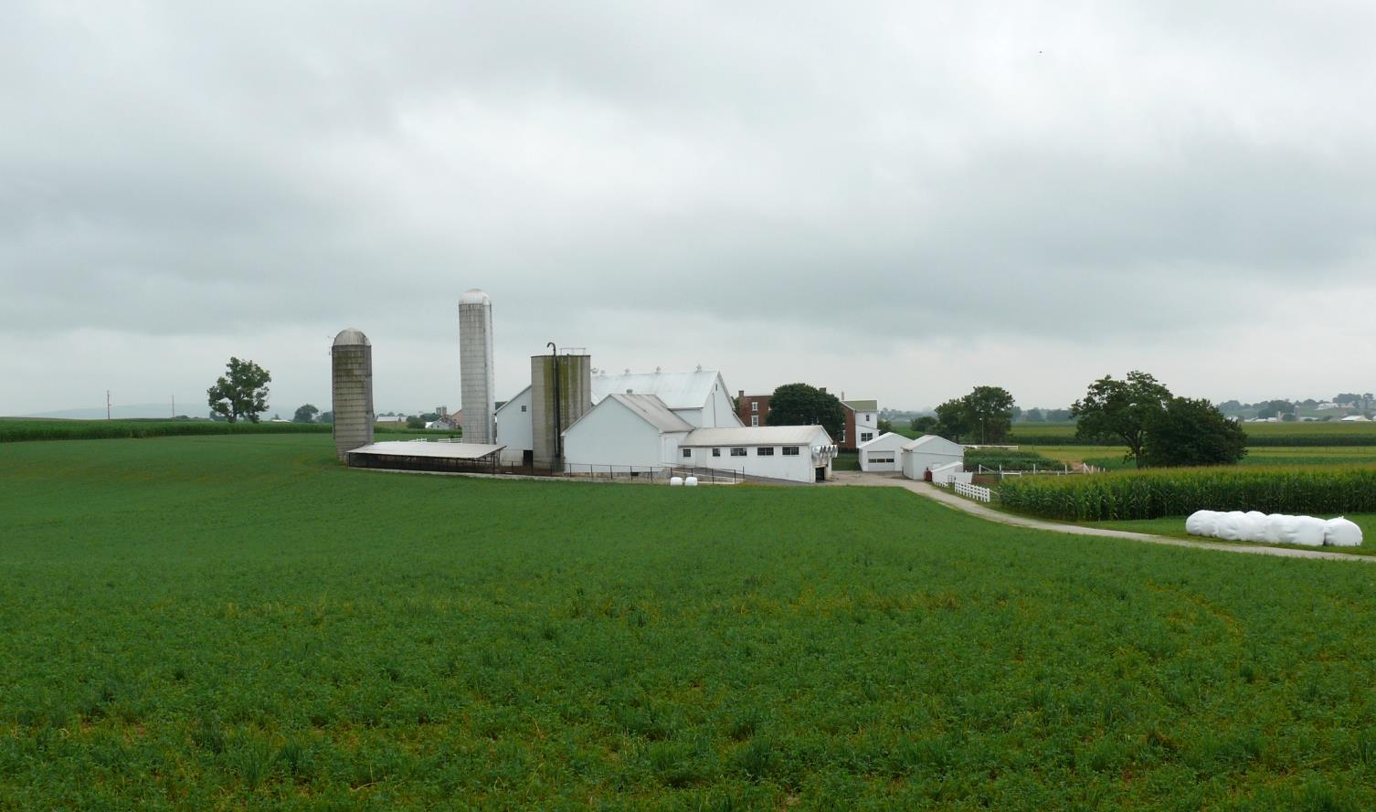
Where do new phenotypes come from?
Barn: Flooring type, bedding materials, density, weather data
Cow: Body temperature, activity, rumination time, feed & water intake
Herdsmen/consultants: Health events, foot/claw health, veterinary treatments
Parlor: yield, composition, milking speed, conductivity, progesterone, temperature
Silo/bunker: ration composition, nutrient profiles
Pasture: soil type/composition, nutrient composition
Laboratory/milk plant: detailed milk composition, mid-infrared spectral data
Source: http://commons.wikimedia.org/wiki/File:Amish_dairy_farm_3.jpg

Slide 19
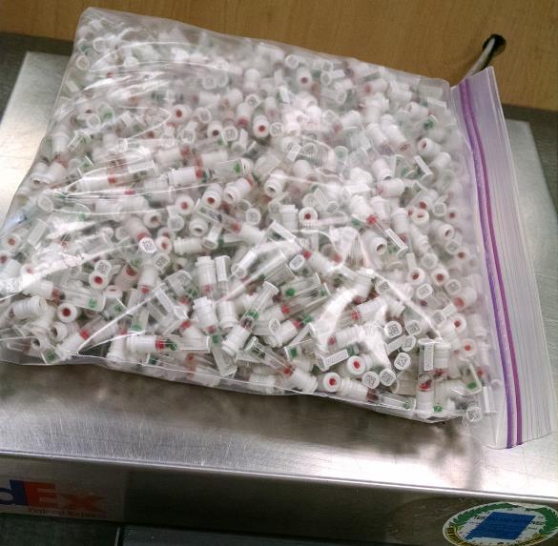
Why select for low-heritability traits?
I was taught that you select for highly heritable traits and manage lowly heritable traits
What has changed since 1991?
Genomic selection makes it
possible to rank bulls for
lowly heritable traits early in
their life
  Health traits average
  >20% reliability gain
  from genomics
Source: Zoetis.

Slide 20

What’s a single SNP genotype worth?
Pedigree is equivalent to information on ~7 daughters
For the protein yield (h²=0.30), the SNP genotype provides information equivalent to an additional ~32 daughters
Notes:
20

Slide 21

What’s a single SNP genotype worth?
And for daughter pregnancy rate (h²=0.04), SNP = ~181 daughters
Notes:
21

Slide 22
Genetic gains are cumulative

Slide 23
Economic aspects of cow health
Costs of preventive care
Diagnostic tests & supplies
Labor
  Farm hands
  Veterinarian
Consumables
Investments
Cost of disease
Treatment
  Diagnostics, labor, drugs discarded milk/meat
Losses
  Reduced milk, growth, product quality
  Increased mortality/culling
Additional cases of disease
<
Source: Hogeveen et al. (2017).

Slide 24
Sick cows are unprofitable cows
Disease | Estimated direct cost*
Hypocalcemia | $38
Displaced abomasum | $178
Ketosis | $28
Mastitis | $72
Metritis | $105
Retained placenta | $64
*Liang et al., 2017; Donnelly et al. (2016).

Slide 25
Balance prevention and treatment costs
Losses higher than necessary
Prevention costs higher
than necessary

Slide 26
Economic values including health
Trait | Economic value ($)
 | NM$ | FM$ | CM$ | GM$
Milk yield | -0.004 | 0.111 | -0.052 | -0.003
Fat yield | 3.56 | 3.56 | 3.56 | 3.31
Protein yield | 3.81 | 0.00 | 5.42 | 3.54
Productive life (PL) | 21 | 21 | 21 | 13
Somatic cell score (SCS) | -62 | 0 | -93 | -57
Udder composite (UC) | 31 | 31 | 31 | 33
Feet/legs composite (FLC) | 10 | 10 | 10 | 11
Body weight composite (BWC) | -20 | -20 | -20 | -22
Daughter pregnancy rate (DPR) | 11 | 11 | 11 | 31
Heifer conception rate (HCR) | 2.2 | 2.2 | 2.2 | 4.1
Cow conception rate (CCR) | 2.2 | 2.2 | 2.2 | 6.4
Calving ability index (CA$) | 1 | 1 | 1 | 1
Cow livability (LIV) | 12 | 12 | 12 | 8.8
Health $ | 1 | 1 | 1 | 0.7

Slide 27
Relative values including health
Trait | Economic value (%)
 | NM$ | FM$ | CM$ | GM$
Milk yield | -0.7 | 20.6 | -7.9 | -0.5
Fat yield | 23.9 | 24.5 | 20.2 | 20.9
Protein yield | 18.4 | 0.0 | 22.2 | 16.1
Productive life (PL) | 13.5 | 13.9 | 11.4 | 7.9
Somatic cell score (SCS) | -3.5 | 0.0 | -4.4 | -3.0
Udder composite (UC) | 7.5 | 7.7 | 6.3 | 7.5
Feet/legs composite (FLC) | 2.8 | 2.8 | 2.3 | 2.9
Body weight composite (BWC) | -5.9 | -6.1 | -5.0 | -6.1
Daughter pregnancy rate (DPR) | 6.8 | 7.0 | 5.8 | 18.0
Heifer conception rate (HCR) | 1.4 | 1.5 | 1.2 | 2.5
Cow conception rate (CCR) | 1.7 | 1.7 | 1.4 | 4.5
Calving ability index (CA$) | 4.8 | 5.0 | 4.1 | 4.6
Cow livability (LIV) | 7.4 | 7.6 | 6.3 | 5.1
Health $ | 2.3 | 2.3 | 1.9 | 1.5

Slide 28
Balancing traits against one another
Health traits are correlated with traits already in our indices
This produces positive correlated response to selection
Placing too much emphasis on lowly heritable traits will cause farmers to lose money
  Correct genetic and phenotypic correlations must be used when constructing indices
Improved cow health is important, but it must be balanced against other traits of economic importance

Slide 29
Conclusions
Genetic selection has been very successful for production traits
Genomics allows us to more accurately select for lowly heritable traits
Genetic gains are cumulative
Sick cows harm profitability because of lost productivity and increased risk of culling

Slide 30
Disclaimers
USDA is an equal opportunity provider and employer
Mention of trade names or commercial products in this presentation is solely for the purpose of providing specific information and does not imply recommendation or endorsement by USDA

Slide 31
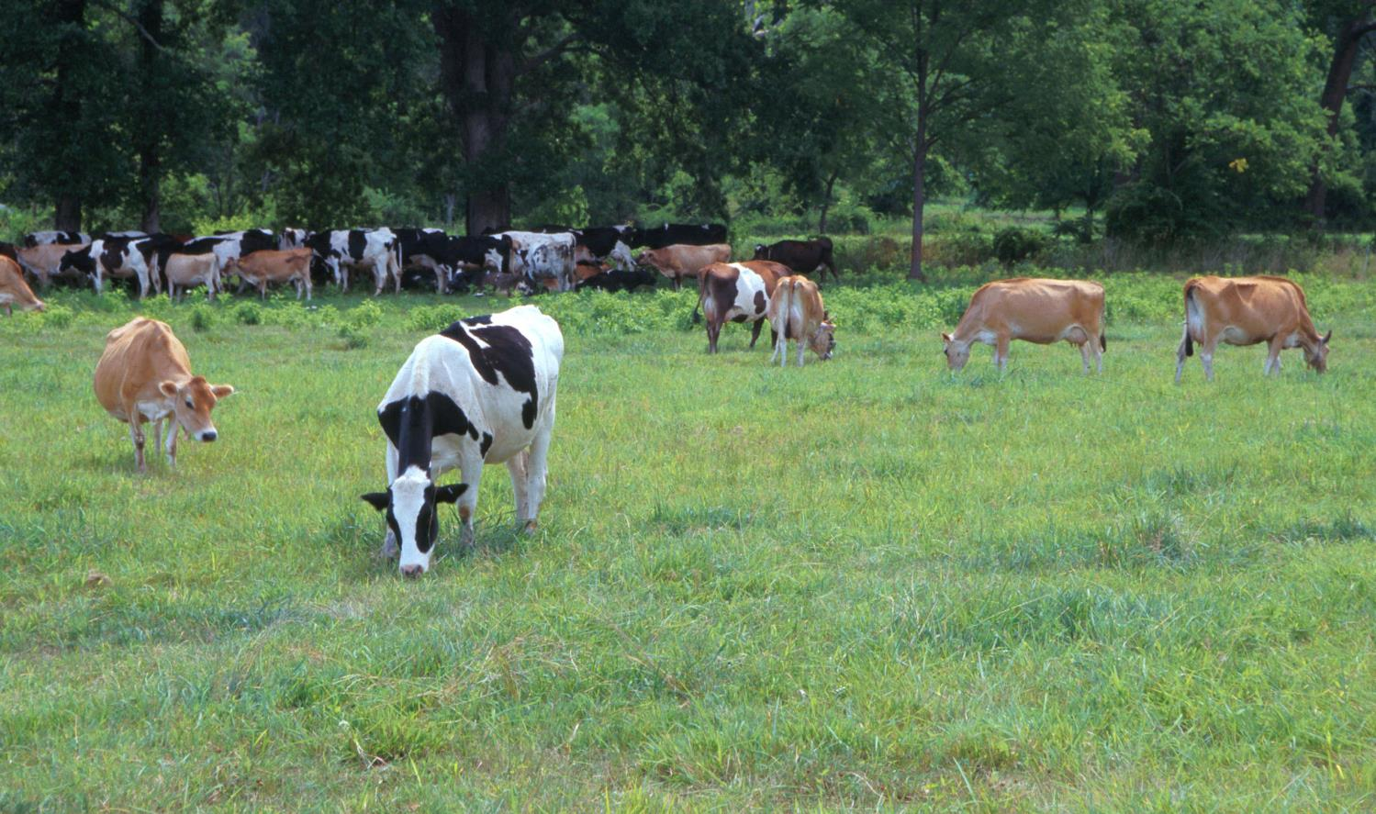
Questions?
AIP web site:
http://aipl.arsusda.gov
Holstein and Jersey crossbreds graze on American Farm Land Trust’s
Cove Mountain Farm in south-central Pennsylvania
Source: ARS Image Gallery, image #K8587-14; photo by Bob Nichols

